Slide 1
Revelation 12-14
The Evil Against God’s People
www.revelationandcreation.com

Slide 2
Important Points
John provides more information regarding the battle which is going on behind the scenes
Gives answer as why there is hostility between Rome and the church
Answers “Why are Christians being treated this way?”
Identifies the source of the conflict (question 1)

Slide 3
Christian Enemy No. 1
2 Corinthians 11:3
2 Corinthians 2:8-11
Ephesians 2:2, 3
Ephesians 6:11-18
2 Thessalonians 2:9
1 Peter 5:8
Revelation 12:9
?
?
?
?
?
?
?
Deception, crafty
Advantage, devices
Course, disobedience
Wiles, fiery darts, etc.
Power, lying wonders
Seeking, devouring
Deceives world
Be Educated, Forewarned, and Fully Armed!

Slide 4
Question 2?
A great sign – symbol – represents something other than the obvious

Slide 5
Woman: 1st Personage (12:1-2)
Woman
vulnerable and relatively defenseless
Clothed in sun, moon and stars
articles of illumination, pure, beautiful, and undefiled
garland (crown, wreath) of twelve stars
badge of victory
She is with child, ready to give birth
conveys hope
looking for someone

Slide 6
The Woman & The Harlot CONTRASTED
Revelation 12
Revelation 17
Clothed with the sun
Standing on the moon
On head a garland of twelve stars
Being with child → produces good
Cries in labor and pain
Mother of martyrs
Gives life
Hunted by evil
Arrayed with purple, scarlet, gold, precious stones, pearls
Sitting on many waters, on a scarlet beast
In hand a golden cup full of abominations
Commits fornication → produces filth
Drunk
Mother of harlots
Takes life
Allied with evil

Slide 7
Woman: 1st Personage (12:1-2)
Question 3?

Slide 8
Woman, The Righteous Remnant (Micah 4:1-12)
Coming of church/kingdom (4:1-5)
“In that day” (4:6-8; cf. v. 1)
assemble lame and outcast, make a strong nation (vv. 6, 7)
“kingdom of the daughter of Jerusalem” (v. 8)
Daughter of Zion is in childbirth pain (4:9-10; i.e., Rev. 12:1, 2)
Persecution and ultimate victory (4:11, 12)

Slide 9
The Dragon 2nd Personage (12:3, 4)
Dragon (Gk. δράκων )
why consider “dragons” any more fictitious than the other symbols of this vision (woman, child, wilderness, serpent)?
John is employing real images to convey spiritual meaning
more than likely, John had a real creature in mind
Leviathan: Job 3:8; 41:ff; 74:14; 104:26; Is. 27:1

Slide 10
The Dragon
The dragon (answering question 4):
Satan (12:9)
from the beginning to the end this satanic serpent lives to oppose God’s plan
Fiery red
murderous (6:4)
dangerous (cf. fiery darts, Eph. 6:16)
recall fiery serpents (Num. 21:6)

Slide 11
The Dragon
Has seven heads:
symbolism as the woman clothed with the sun and standing on the moon
7 = complete
head → intelligence, craftiness, cunning in worldly wisdom
2 Corinthians 11:3

Slide 12
The Dragon
Ten horns
horn → symbol of power (cf. 5:6)
ten → excels with power/rule
plagues
commandments
“God Said” (Gen. 1)

Slide 13
The Dragon
Seven diadems
diadem → ruling crown
expresses his rule and domain
ruler of the world (Jn. 12:31; 14:30; 16:11)
god of this age (2 Cor. 4:4)
prince of demons (Matt. 12:24)
Prince of the power of the air (Eph. 2:2)

Slide 14
The Dragon’s Work
Drew a third of the stars of heaven and cast them to the earth (v. 4)
perhaps a reference to his influence among rulers and even angels who followed his rebellion (cf. v. 9; 2 Pet. 2:4)
expansion of darkness
Satan’s strength and activity reaches far!
the startling visual contrasting a helpless woman before a towering dragon should never be lost in the details

Slide 15
The Dragon’s Work
Stands before the woman to devour the child
opposes Christ’s redemptive work
Satan was the source behind Herod’s cruel deeds (Matt. 2:16; Jn. 8:44)
QUESTION: “Why not destroy the woman before she gives birth?”
ANSWER: He tried!

Slide 16
Satan’s Long Age of Opposition
He always has and always will seek to derail the cause of Christ
inspired Eve to eat of the forbidden tree
worked through Cain to kill his brother (1 Jn. 3:12)
through the ages sought to destroy the woman (God’s people)
sought to destroy the “Seed promise” to Abraham wherein all families would be blessed…

Slide 17
Satan’s Near Misses
Only one family left (Gen. 6:5-10)
Aged Abraham & Sarah with no children (Gen. 17)
The vulnerable baby Moses in a basket (Ex. 1)
The bondage that seems inescapable (Ex. 1)
The nation in complete apostasy (Ex. 32; Jud. 2:9)
David before Goliath (1 Sam. 17)
David hunted by Saul (1 Sam. 18ff)
Athaliah’s attempt to destroy the Messianic line (2 Kin. 11:1ff)
Haman’s attempt to destroy all the Jews (Esther)
Herod’s attempt to destroy Jesus (Matt 2)
Mark Dunagan

Slide 18
The Male Child: 3rd Personage (12:4, 5)
despite the devil’s plan, the child was born and succeeded to rule
question 5?

Slide 19
The Male Child: 3rd Personage (12:4, 5)
ANSWER: the male child is Jesus
rules the nations
Ps. 2:6-12; Rev. 1:5; 19:15; Is. 9:6
the dragon’s plans were foiled to destroy the Child—born and then caught up to God
12:5 goes from the birth to His throne (ascension)
Satan had tried to destroy Jesus throughout His ministry (Matt. 4:1; Mk. 8:31-33; Lk. 22:3-6, 53)
the resurrection and ascension defeated Satan (Heb. 2:14-18; Eph. 1:20, 21)

Slide 20
Fleeing to Wilderness (v. 6)
Frustrated over the Child’s escape, the dragon turns on the woman (cf. 12:13)
Taken to a place prepared by God
Nourished and preserved
1260 days (42 months; 3 ½ years)
the duration of the holy city (church) being trampled (11:2)
witnesses would prophesy (11:3)
this passage is enlarged upon in 12:14-17
POINT: As God provided for His Son, so He provides for His church

Slide 21
WAR IN HEAVEN (12:7-9)
War in heaven
Not necessarily a literal war
demonstrates conflict between God and Satan
Not told “when” this war happened
AVOID: the imaginative assumption of a heavenly war before the creation where Satan was defeated and thrown out of heaven by Michael
likely the “war” was during Christ’s personal ministry and perhaps during the very crucifixion where the victory is anchored (Rev. 12:11)

Slide 22
SATAN’S ORIGIN & FALL?
AVOID: attributing Isaiah 14:12 to define Satan’s fall
speaks of the king of Babylon (Is. 14:4)
CREATED
Ephesians 3:9
CREATED SPIRITUAL
Ephesians 6:11, 12
SINNED & FELL INTO CONDEMNATION
1 Timothy 3:6; 1 John 3:8; John 8:44

Slide 23
SATAN’S ORIGIN & FALL?
The “FALL” and “binding” of Satan has nothing to do with some era after Jesus’ second coming
when Jesus comes a second time, Satan will be thrown into hell fire (Rev. 20:10)
when Jesus came the first time, Satan was being bound and his work lessened
Gen. 3:15; Matt. 12:24-29; Lk. 10:17-21; Jn. 12:31-33; Col. 2:14, 15; Heb. 2:14
Revelation 12 begins with the birth of Jesus and emphasizes his death and ascension (12:5, 11)

Slide 24
Michael: 4th personage (12:7-9)
question 6
Identifying Michael
archangel (Jude 9)
distinguished from Christ (1 Thess. 4:16; Heb. 1:5ff)
“chief prince” (Dan. 10:13)
“great prince” (Dan. 12:1)
symbolism of the conflict between good and evil

Slide 25
The Effect of the War
Satan did not prevail
he often looks like he is winning, but he ultimately fails!
exaggerates appearance, fearsomeness, and luxury of lies
good and evil are not equally poised & balanced forces

Slide 26
SATAN’S LIMITATIONS
Satan’s loss proves Satan is not God!
he is intelligent (7 heads)—but not omniscient
did not know he would lose the war
contrast Acts 1:24
he has great authority (7 diadems)—but he is not all-powerful
contrast Christ’s many crowns (Rev. 19:12, 16)
he watches man, but is not omnipresent (Job 1:7; contrast Jer. 23:24; Acts 17:27)
he is dreadfully fearsome but can be overcome by the Seed of woman (Rev. 12:11; Jas. 4:7)

Slide 27
The Effect of the War
No place found in heaven any longer
could not accuse brethren anymore before God (v. 10)
why?

Slide 28
Why Satan Can Not Accuse
Jesus ascended to heaven (v. 5)
ascended as mediator
ascended as high priest (Heb. 4:14-16; 7:24-26; 8:1, 2)
when we contact His redeeming blood in baptism, there is no past sin that the devil can prosecute us with (Rev. 1:5; 12:11)

Slide 29
The Names Of Satan—Revelation 12:9 (Questions 7)
“Devil” (diabolos)
slanderer or accuser
“prone to slander, slanderous, accusing falsely” (Strong’s 1228)
compare 12:10 to Job 1:9-11; 2:4, 5
“Satan” (Satanas)
“adversary (one who opposes another in purpose or act)” (Strong’s 4567)

Slide 30
Three Works Of Satan (Questions 8)
“deceives the whole world” (cf. 1 Jn. 5:19)

Slide 31
The Loud Voice (12:10-12)
Speaks of victory and defeat:
“salvation” –victory of God’s plan
“strength” –victory of God’s ability
“the kingdom” –victory of God’s church
“power” –the authority of God’s Son
“Christ” –victory of the Male Child
“they overcame him” –victory of Christians
“has been cast down” –defeat of Satan and his work (cf. Rom. 8:33-39)
NOW!

Slide 32
DEFEATING SATAN (Question 9)
OVERCOME (v. 11)
by the blood (reached in baptism, Rom. 6:3, 4)
by their testimony
confession without shame, cf. Lk. 9:26

Slide 33
Their Testimony (v. 11)
“Can one imagine any of these Christians willing to forsake the assembling of the saints or being indifferent about their hope of eternal life? The committed Christian bears witness by his words and actions as to whether or not he loves the Lord: on the job, among friends, the language he speaks, his manner of dress, the company he keeps, the places he frequents, and the love he manifests. All of these things testify what is the state of one’s heart. He either loves the Lord, or he is a hypocrite (Gal. 6:7-8).”
(Harkrider, Robert “Revelation” Truth Commentaries, p. 141)

Slide 34
DEFEATING SATAN (Question 9)
OVERCOME (v. 11)
by the blood (reached in baptism, Rom. 6:3, 4)
by their testimony
confession without shame, cf. Lk. 9:26
did not love lives to the death

Slide 35
“did not love their lives to the death”
“Their testimony bore witness to their total commitment and love of the Lord. They did not cherish life even though they faced martyrdom. They gave up everything to serve Christ, but they gained far more than they lost. The worldly minded will compromise in the name of “common sense” in an attempt to avoid what they call fanaticism. Why would anybody choose persecution over the pleasures of this world? Only those who understand the words of Jesus: “He that loveth his life shall lose it; and he that hateth his life in this world shall keep it unto life eternal’ (John 12:25). The authentic follower of Christ has his values and priorities clearly in view.”
(Robert Harkrider, p. 141, 142.)

Slide 36
“did not love their lives to the death”
“Notice that the text does not say that the Christians loved martyrdom. It says they loved “not their lives”. This is not a discussion of how they viewed death, but rather how they viewed their lives. If their life is committed to God, then the issue of death is already taken care of. If I am right with God, then there is nothing to fear concerning death (Luke 12:4-5; Matthew 16:25). Consider the truth that great commitment brings great confidence. At times Christians lack confidence in their salvation, in the future, or concerning death, and often such a lack of confidence is due to a half-hearted commitment.”
(Mark Dunagan)

Slide 37
Heaven Rejoices; Woe to the Earth (v. 12) Question 10
Heaven rejoices because there is no place for Satan in heaven (v. 8)
he cannot accuse brethren
any wonder why heaven erupts in joy when one sinner repents (Lk. 15:7)?

Slide 38
Heaven Rejoices; Woe to the Earth (v. 12) Question 10
The earth has woe because
Satan is turning his attention to punishing those who are named in the book of life
intense persecution will come

Slide 39
The Persecution and Preservation of the Woman (12:13-17)
Satan recognized his defeat in heaven and adjusted his tactics to persecute those on the earth (v. 13)
“persecuted the woman” (v. 13)
“enraged” (v. 17)
“make war” (v. 17)

Slide 40
The Persecution and Preservation of the Woman (12:13-17)
The woman was given two wings of a great eagle to fly into the wilderness to “her place”
apart from God, she would have no chance (Rev. 12:1-4)
God provides for her escape, refuge, and spiritual nourishment during the “3 ½” yrs. hardship
“wilderness” represents a place of salvation and is in contrast to the “great city” (11:8)
it is not her “destination” anymore than the wilderness was Israel’s—a stopping place on the way to the promised land!

Slide 41
The Persecution and Preservation of the Woman (12:13-17)
The woman was given two wings of a great eagle to fly into the wilderness to her place
reminiscent of Pharaoh and God’s deliverance of Israel (Is. 51:1-11, see v. 9, 10)
“rahab” (cf. Is. 30:7) & “serpent” (dragon, KJV)
“You have seen what I did to the Egyptians, and how I bore you on eagles’ wings and brought you to Myself. Now therefore, if you will indeed obey My voice and keep My covenant, then you shall be a special treasure to Me above all people; for all the earth is Mine” (Ex. 19:4)

Slide 42
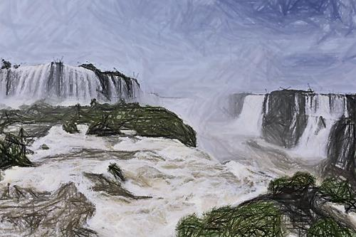
The Serpent’s Flood and the Earth’s Help (12:15, 16)
A flood of evil (Ps. 18:4-6, 16-19)
The earth helped the woman
Psalm 66:5-7; Numbers 16:31-33
earth = the rest of the world’s inhabitants (Harkrider)
perhaps diverting the attention away from Christians by unrest, policy changes, etc.
likely some kind of divine intervention

Slide 43
The Rest Of Her Offspring (v. 17)
The woman (church) could not be destroyed by the dragon (Satan)
The rest of her offspring, viz., individual disciples can have their physical existence destroyed (Rev. 2:13)
2 Timothy 3:12, “Yea, and all that will live godly in Christ Jesus shall suffer persecution.”

Slide 44
The Rest Of Her Offspring (v. 17)
The main objective of Satan’s assault against disciples is not physical, but spiritual
those he physically killed were taken into a realm where he could no longer harm them (Rev. 14:13)—ANOTHER DEFEAT AGAINST SATAN!
however, “FEAR” (of death, torture, etc.) could be an effective weapon against disciples to make them compromise with evil
Deuteronomy 31:6-8
Isaiah 51:6-8
Matthew 10:28-31
Revelation 2:10

Slide 45
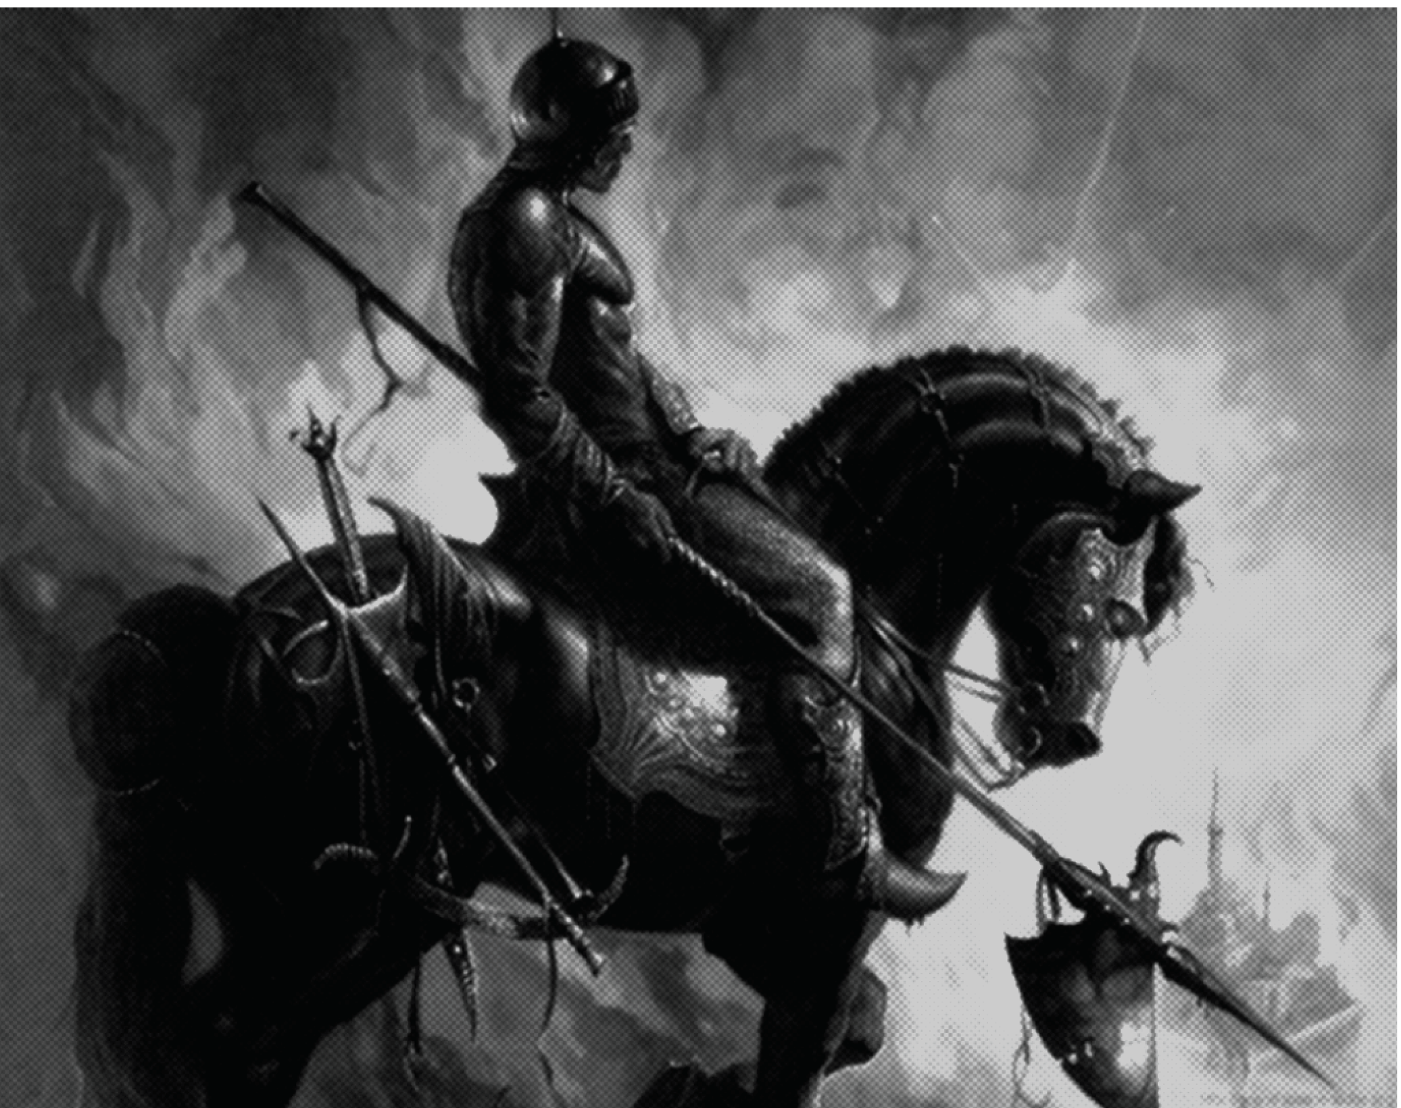
Revelation 12:17
“And the dragon was enraged with the woman, and he went to make war with the rest of her offspring, who keep the commandments of God and have the testimony of Jesus Christ.”
“to make war” not “to make a scuffle”
Satan declares war against…
1 Timothy 6:12; 2 Timothy 2:3; Ephesians 6:12

Slide 46
Applications
If we are going to overcome:
We need to have confidence that we can overcome
“These things I have written to you who believe in the name of the Son of God, in order that you may know that you have eternal life’ (1 John 5:13).”
We need to apply the blood of the Lamb
Revelation 12:10, 11

Slide 47
Applications
The tremendous price paid by Jesus and the shedding of innocent blood throughout the ages should humble us in the faith (12:11)

Slide 48
Applications
Boldness in Christ is to be cherished above peace in life (12:11)
“Whoever is ashamed of Me and of My words in this adulterous and sinful generation, of him will the Son of man also be ashamed, when He comes in the glory of His Father’s with the holy angels” (Mark 8:38)

Slide 49
Notable Quote
“That’s Jesus Christ talking. He is direct. He is speaking to the Embarrassed Believer, cowed and hiding. ‘I am not ashamed of the gospel’, wrote Paul to the Romans. When Paul penned that bold proclamation, he was preaching to a world more than merely hostile to his faith. It was a world willing to execute believers. In other words, there was in Paul’s day a very genuine risk to belief. Yet the imprisoned Paul wrote to his colleague Timothy, ‘Do not be ashamed then to testifying to our Lord, nor of me His prisoner” (2 Timothy 1:8). Time and authorities had caught up with Paul. When he wrote to Timothy it is almost certain that he knew the price he would eventually pay. Still, he urged Timothy to ‘share in suffering for the gospel’. . .

Slide 50
. . .Now the Embarrassed Believer has already begun to put some distance between Christ’s words cited above and herself, between Paul’s double imperative and himself. The Embarrassed Believer is happy to have nearly two thousand years of possible ambiguity to put between Scripture and today. Boldness and embarrassment mean different things in different centuries, right? Nowhere does the church appear less confident than in the United States. The church’s failure to contend vigorously for the mind and the soul, and to do so publicly with a strong and defensible claim for truth, opens up a gap in the lives of millions. The Embarrassed Believer is silent, and silence is a condition that does not last long in modern America. The quiet has been displaced by a cacophony of voices, each one selling a different, non-Christian ‘meaning’”
The Embarrassed Believer, Hugh Hewitt, pp. xi-xii

Slide 51
Applications
Those who overcome are true believers not
bystanders or spectators
Believers attend church services on a very regular basis. It is unusual for them to not be there. Bystanders attend infrequently.
Believers teach their children and other’s children the essentials of the faith. Bystanders entrust that chore to others. When is the last time you have taught someone?
Believers talk to others about Christ, even if they find it unpleasant. Bystanders are theoretically willing to do so if approached but have never been approached.

Slide 52
Applications
Believers read Scripture though it takes work and effort. Bystanders intend to get around to it.
no job is beneath a believer. Bystanders don’t want many jobs, but can sacrifice themselves for leadership positions if coaxed and pleaded with.
Believers honor the men who lead the congregation. Bystanders, when they notice church leaders at all, are consistent only in their willingness to critique.
Believers savor and seek more and more teaching about God. Bystanders have what they need and would rather not be bothered.
Hugh Hewitt

Slide 53
Applications
“Salvation obtainers” rather than “self-esteem builders”
religion today has become a pastime rather than a passion

Slide 54
SALVATION or SELF-ESTEEM?
Assembly no longer a place of worship, but a holy gymnasium & family counseling center
Turned from “scripture” to “need gratification”
Instead of saving souls, the modern church tries to compete in secular gratification with a world that is a master of the art
Elders, no longer spiritual leaders, but board members, directors, and corporate managers
Preachers, no longer heralds of the gospel, but professional staff managers
From Mark Dunagan’s Sermon on Revelation 12

Slide 55
SALVATION or SELF-ESTEEM?
“American churches seemed more concerned to save marriages than souls, more interested in self-esteem than salvation, and more concerned to relieve depression and anxiety than to deal with the fundamental reality of sin”
(Hugh Hewitt, The Embarrassed Believer, pp. 30-31).

Slide 56
The Preacher
“He often is an actor, concerned more with his role, his manners, and his polished delivery, than with the possibility of his lips being touched with a live coal from the altar”
(ibid, p. xii).

Slide 57
“Secular Christians”
Become more self-centered and demanding of attention
Use God as their instrument for getting a service rather than using their instruments of service to God

